Slide 1
Ms. Stephanie’s
Preschool
Thank you for your purchase!
Please email me at ms.stephaniespreschool@yahoo.com if you have any comments or questions.
I made these activities for use in the preschool classroom, home-based preschool, and for stay-at-home moms and dads of preschoolers.
Please visit my blog at msstephaniespreschool.com for more ideas on how to use these activities.
Trouble printing, try checking the ‘scale to fit paper’ option.
Pages 2-22 Prewriting pages in black and white.
Pages 23-43 Prewriting pages in color. Laminate for reuse.
Pages 44 & 45 Covers

Slide 13


Slide 26



Slide 27









Slide 28




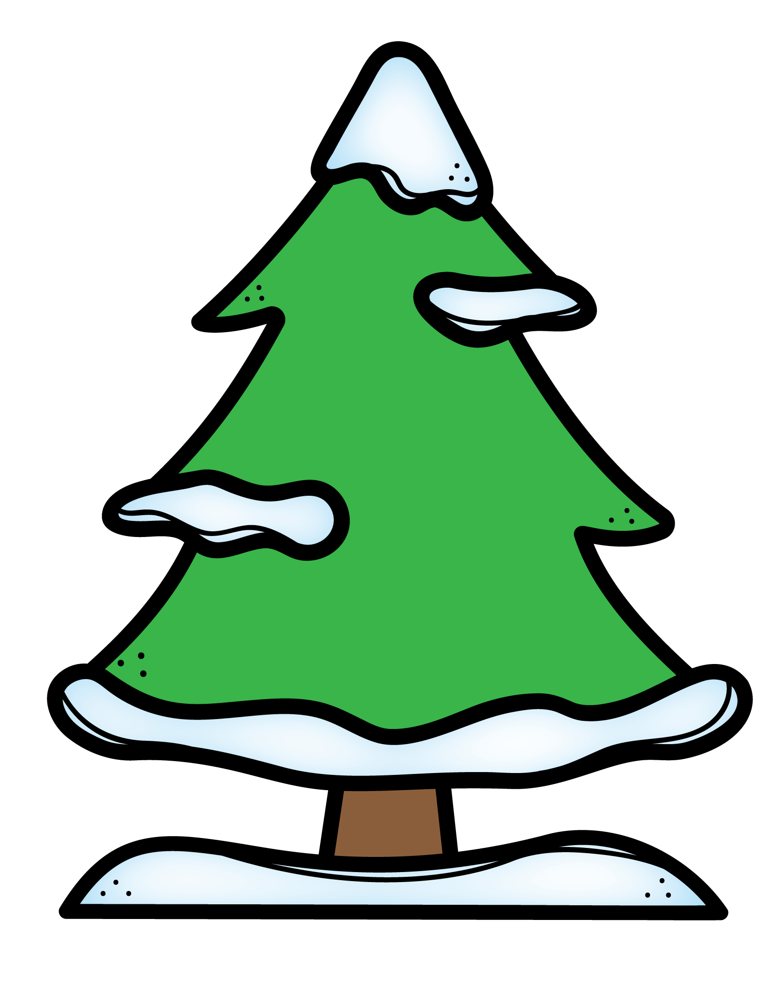
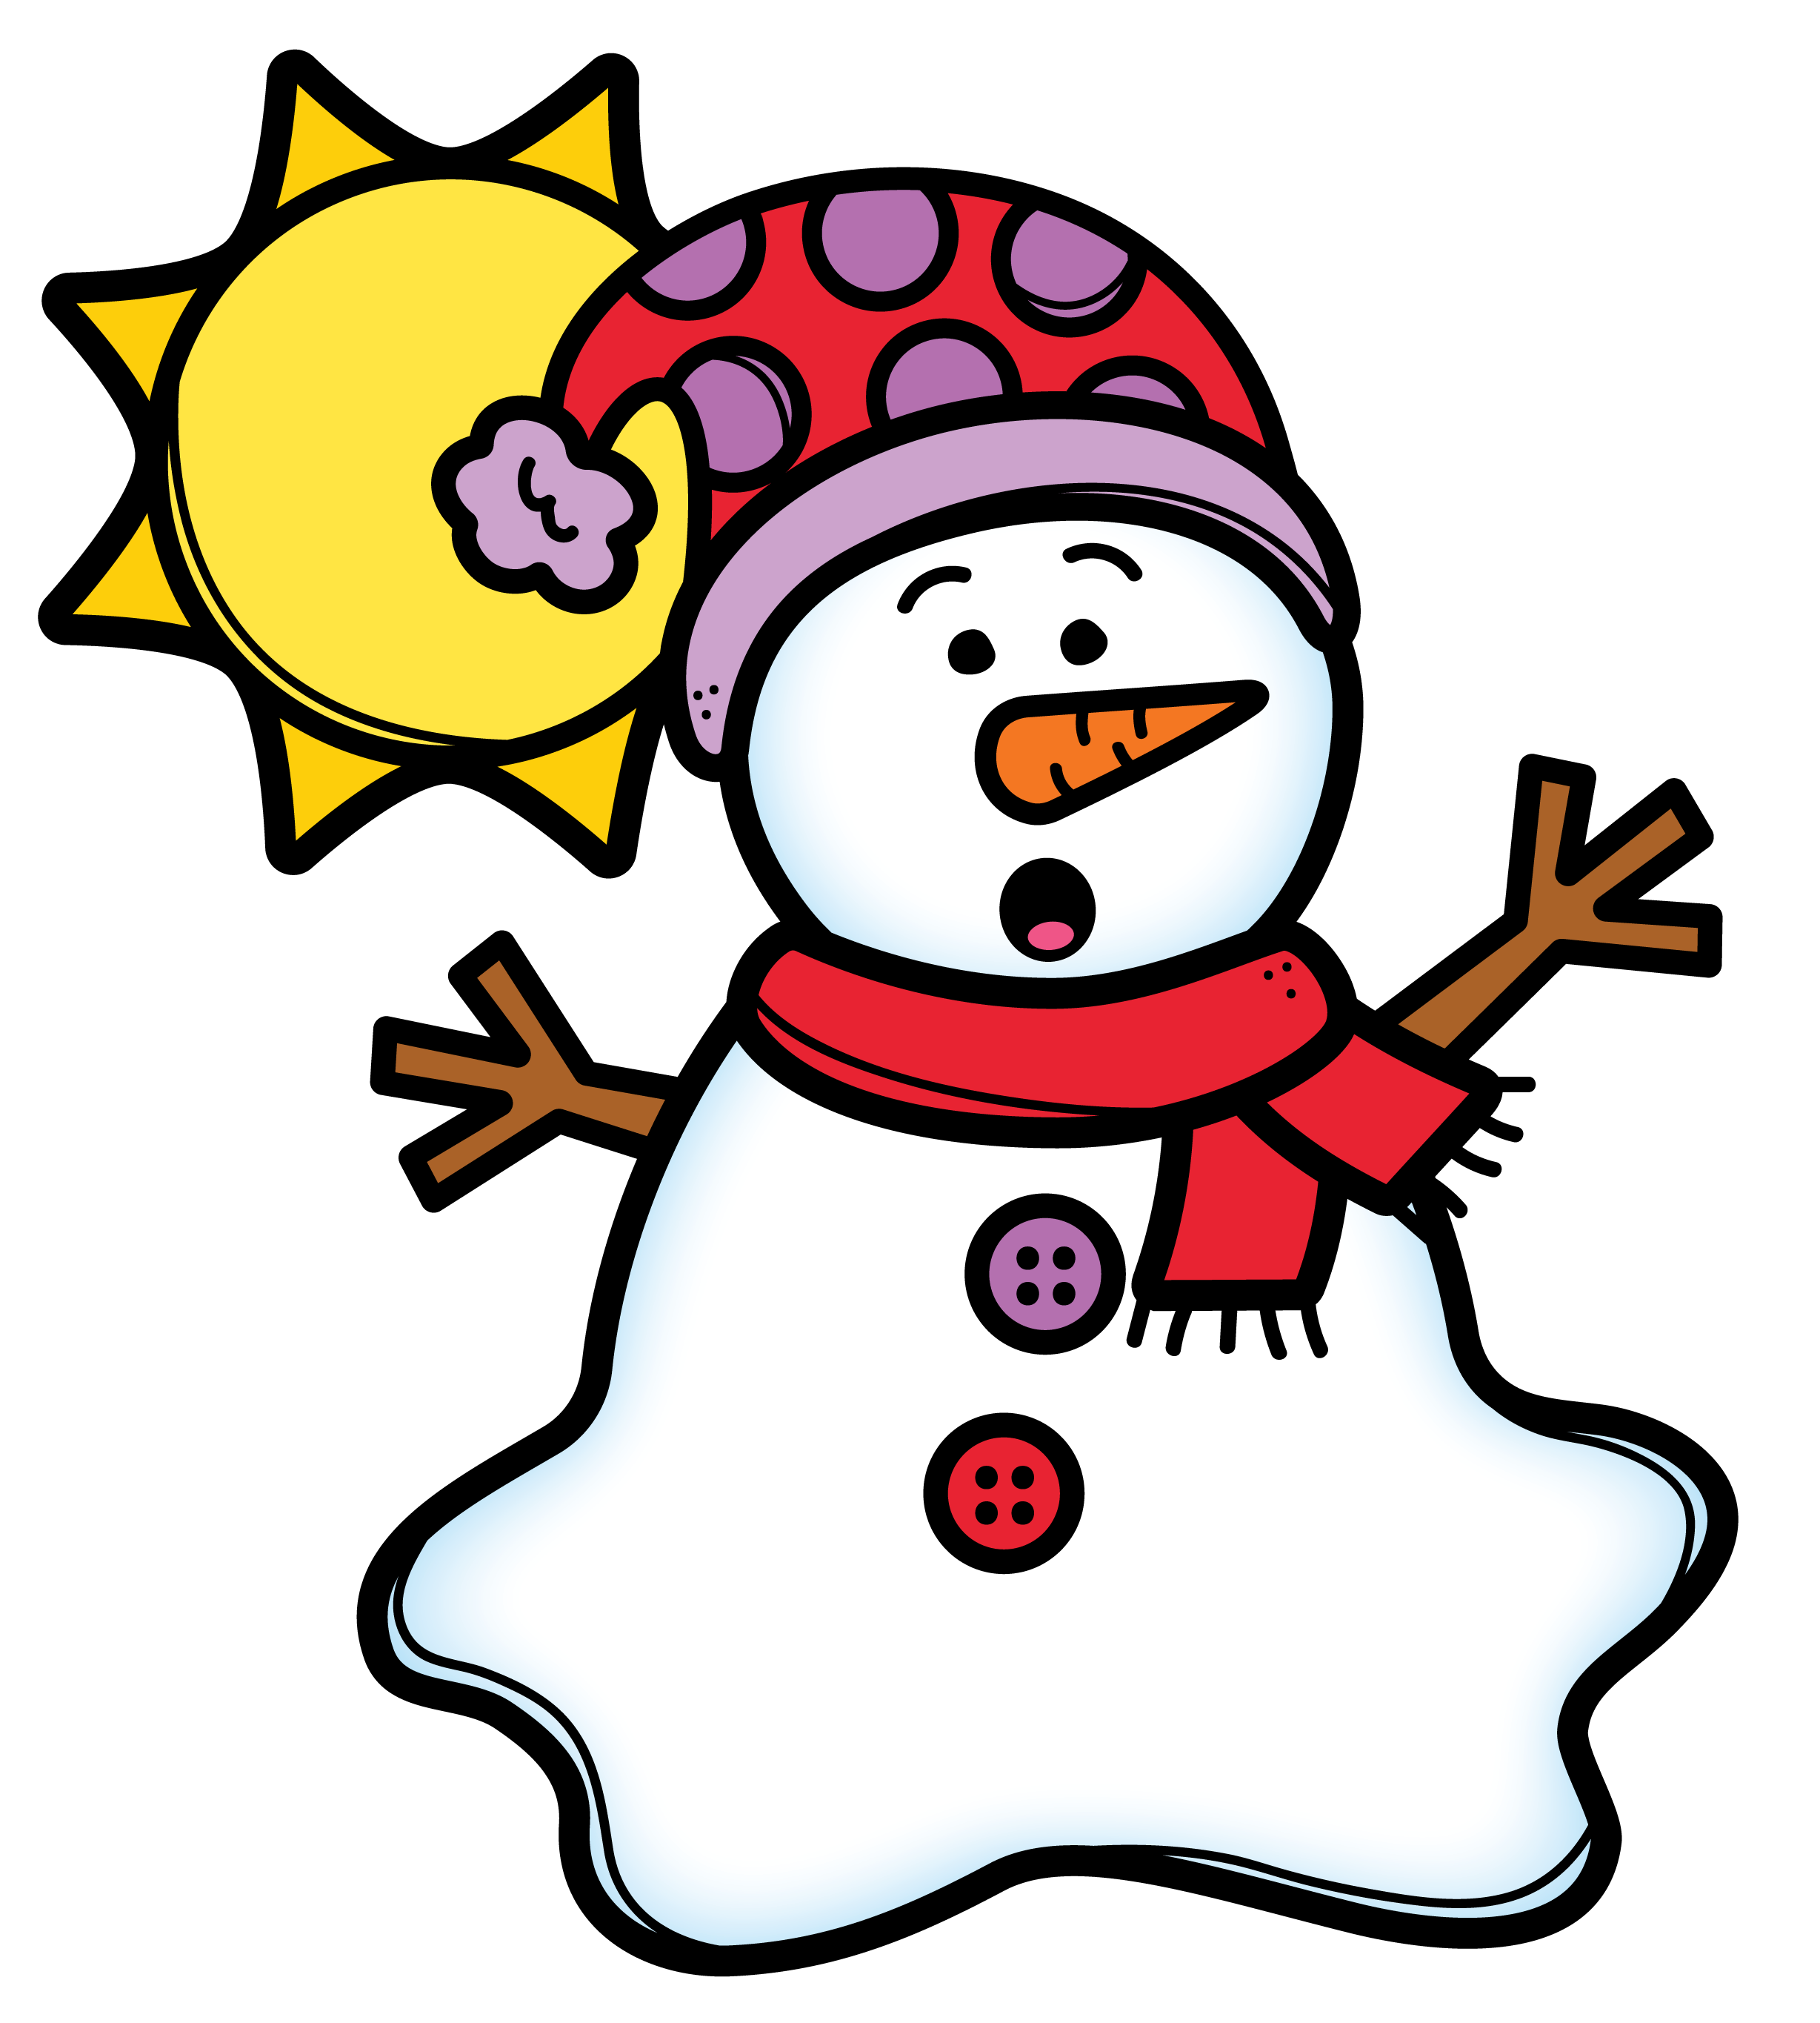


Slide 29









Slide 30






Slide 31


Slide 32



Slide 34
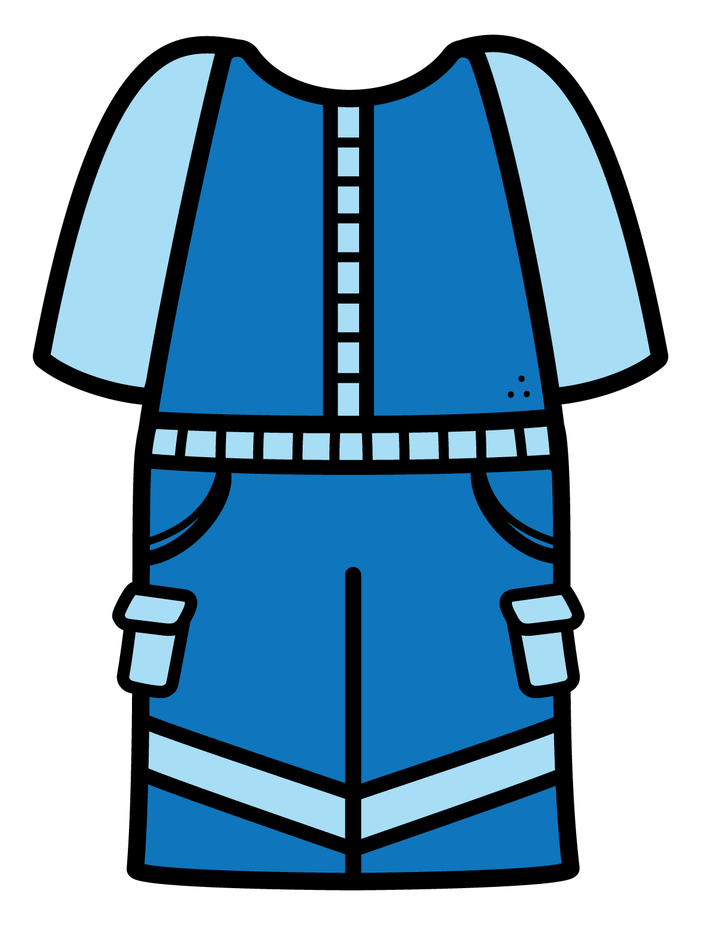




Slide 36


Slide 39


Slide 41


Slide 42


Slide 43

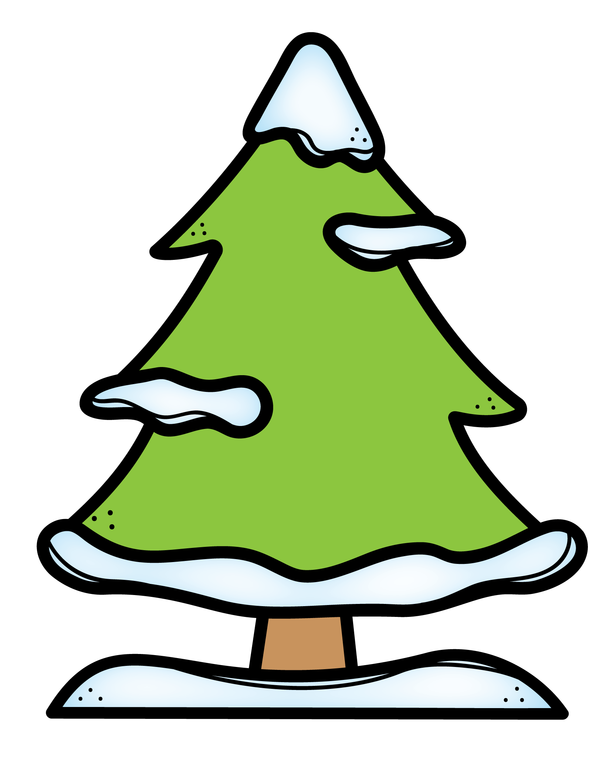

Slide 44
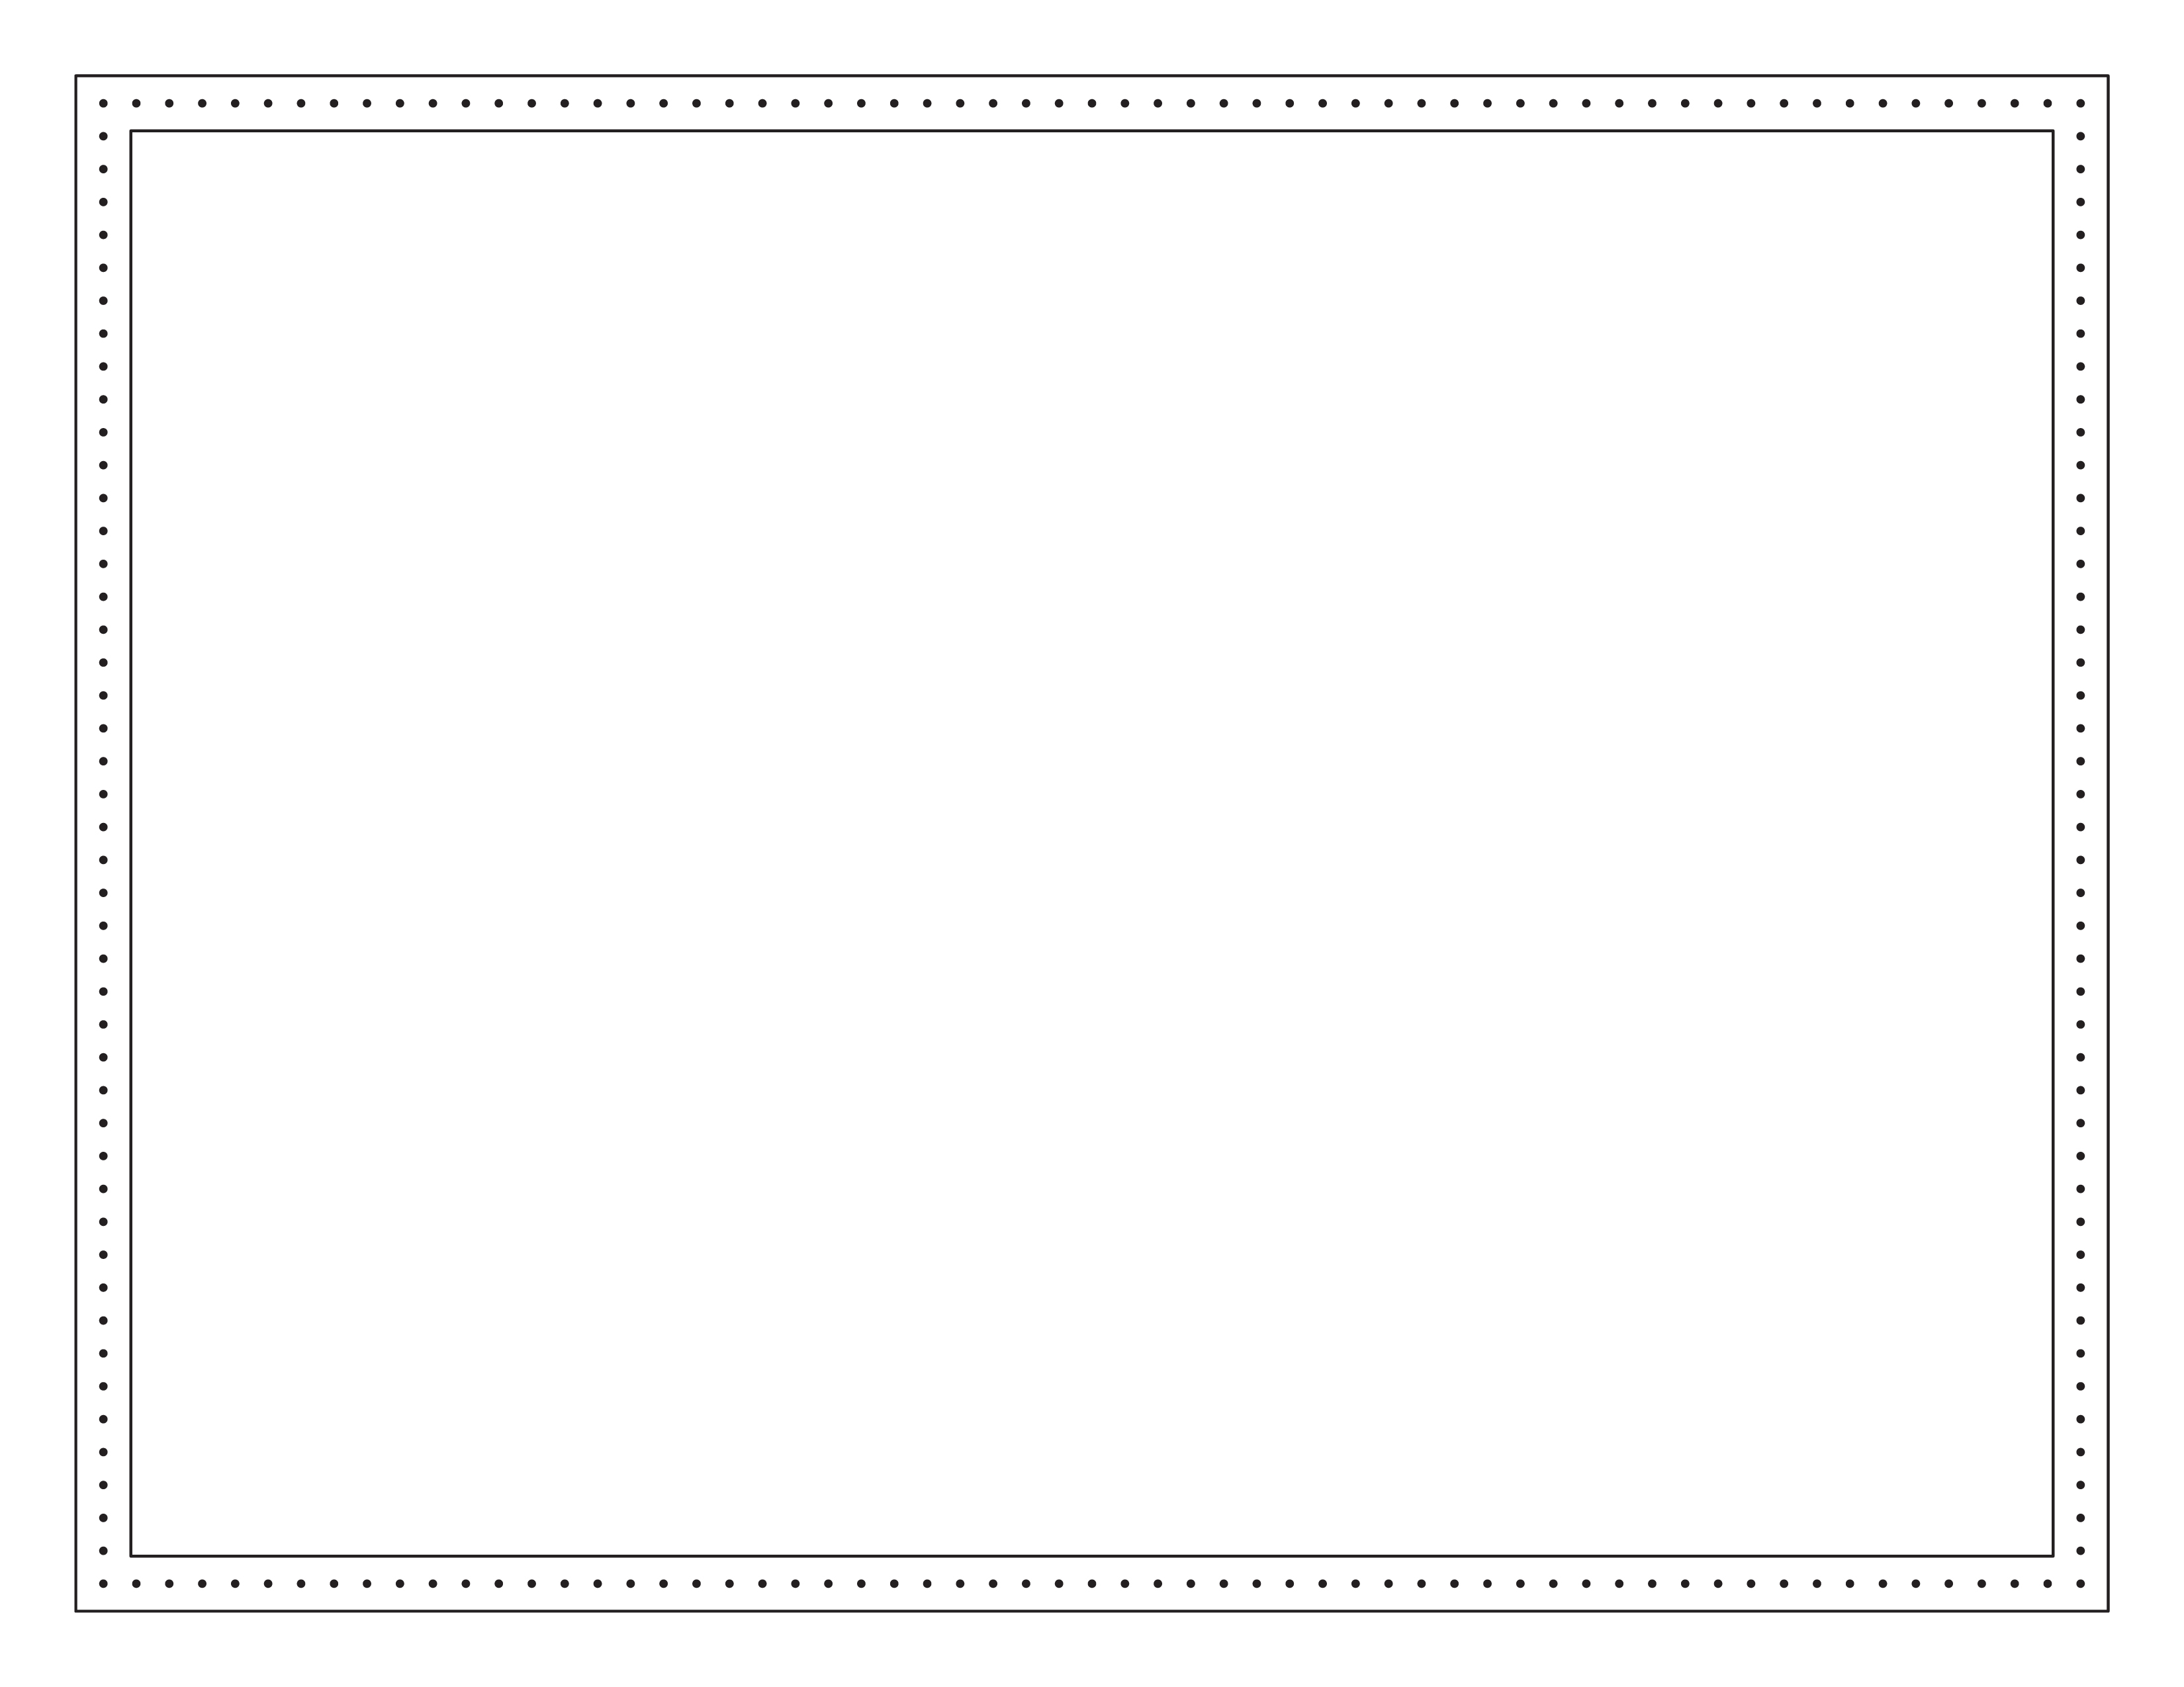
Winter
Prewriting Notebook

Slide 45
Winter
Prewriting Notebook

Slide 46


Ms. Stephanie’s
Preschool
Terms of use:
This product is bound by copy right laws.
You may:
Use items for your own classroom students or your own personal use.
You may not:
Claim this work as your own or alter the files in any way.
Sell the files or combine them into another unit for sale or for free.
Post this document for sale or free elsewhere on the internet, including Google Docs links on blogs.
Make copies of purchased items to share with others.
Credits:
Fonts are from Kimberly Geswein Fonts
Clipart:
https://www.teacherspayteachers.com/Product/P4-FREE-Snowflakes-and-Digital-Paper-P4-Clips-Trioriginals-Clip-Art-2933784
https://www.teacherspayteachers.com/Store/Rainbow-Sprinkle-Studio-Sasha-Mitten

